Slide 1
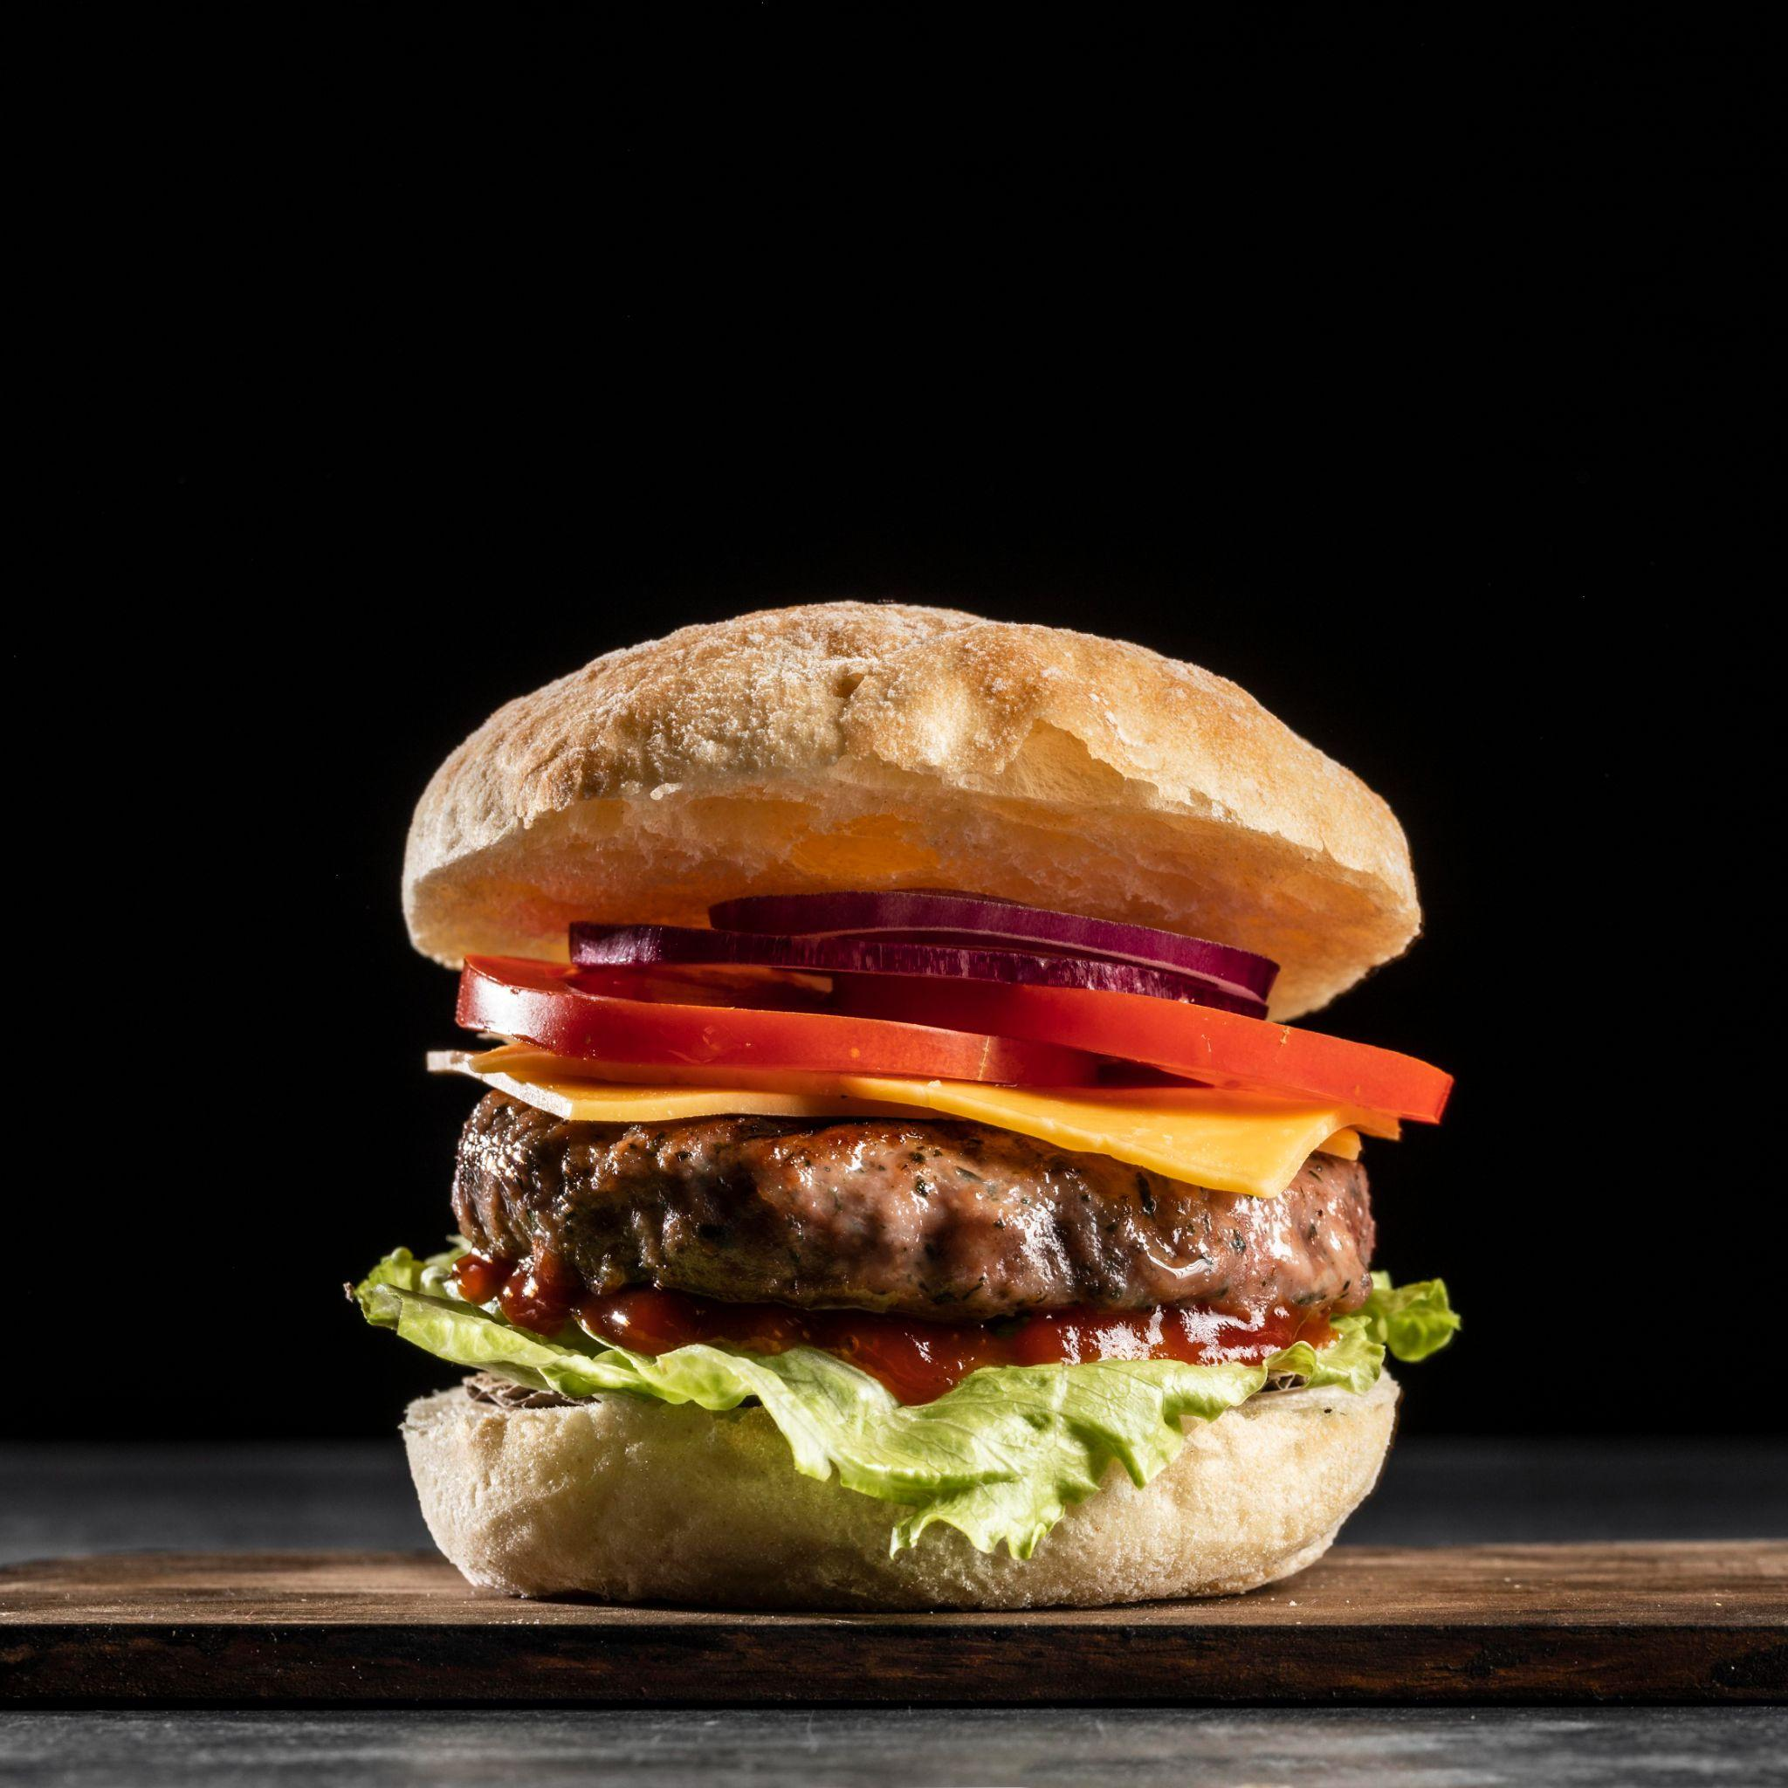
SnackStream Food Delivery
Saba, Wafeeq, Shubhang

Slide 2
Our Statement
The problem SnackStream aims to solve is the need for a seamless, user-friendly mobile application for food enthusiasts to order food items from their desired local restaurants.
Currently, users face challenges in finding an efficient and convenient platform that integrates browsing restaurants, placing orders, profile creation and real-time order tracking.
This app will cater to food enthusiasts who want a convenient and efficient way to enjoy their favorite meals from local restaurants.

Slide 3
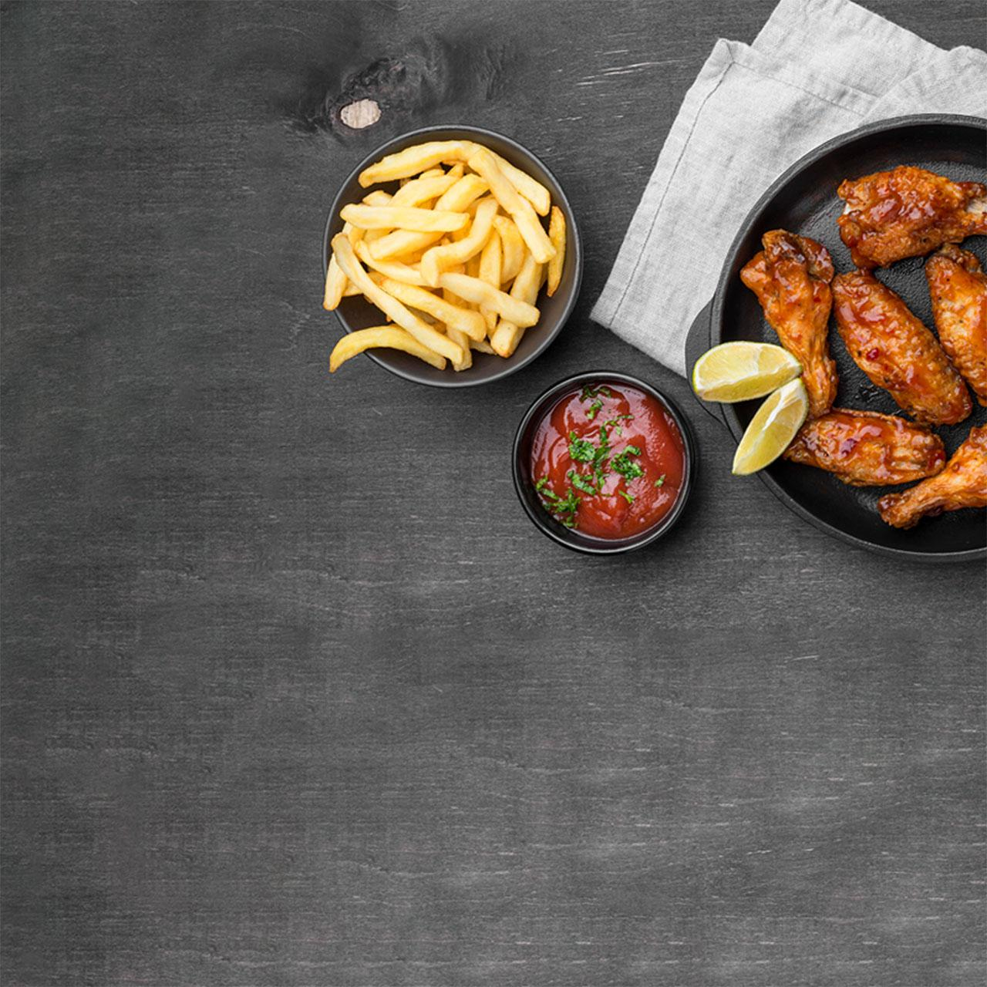
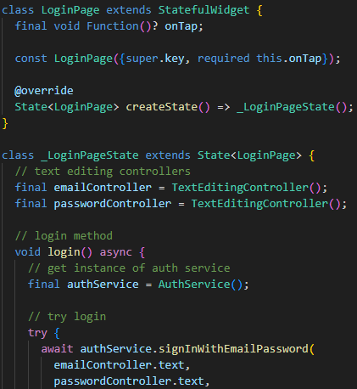
General Requirements
Inputs:
Address information
Restaurant selection
Menu item selection
Order details
Payment Information
Login information (name, email and password)
Outputs
Restaurant list
Menu details
Order summary
Real-time order tracking
User reviews

Slide 4

Design Overview
Homepage:
Hamburger menu, Food options, Address information, Checkout button
Review page:
Reviews of foods that you’ve ordered and one page for drivers.
Restaurant Page:
Displays menu, reviews, restaurant info; add items to cart.
Cart Page:
Shows selected items, modify quantities, order summary, checkout button.
Order Tracking Page:
Real-time tracking, status updates, map view.
Payment Page:
User info, Payment, settings.

Slide 5
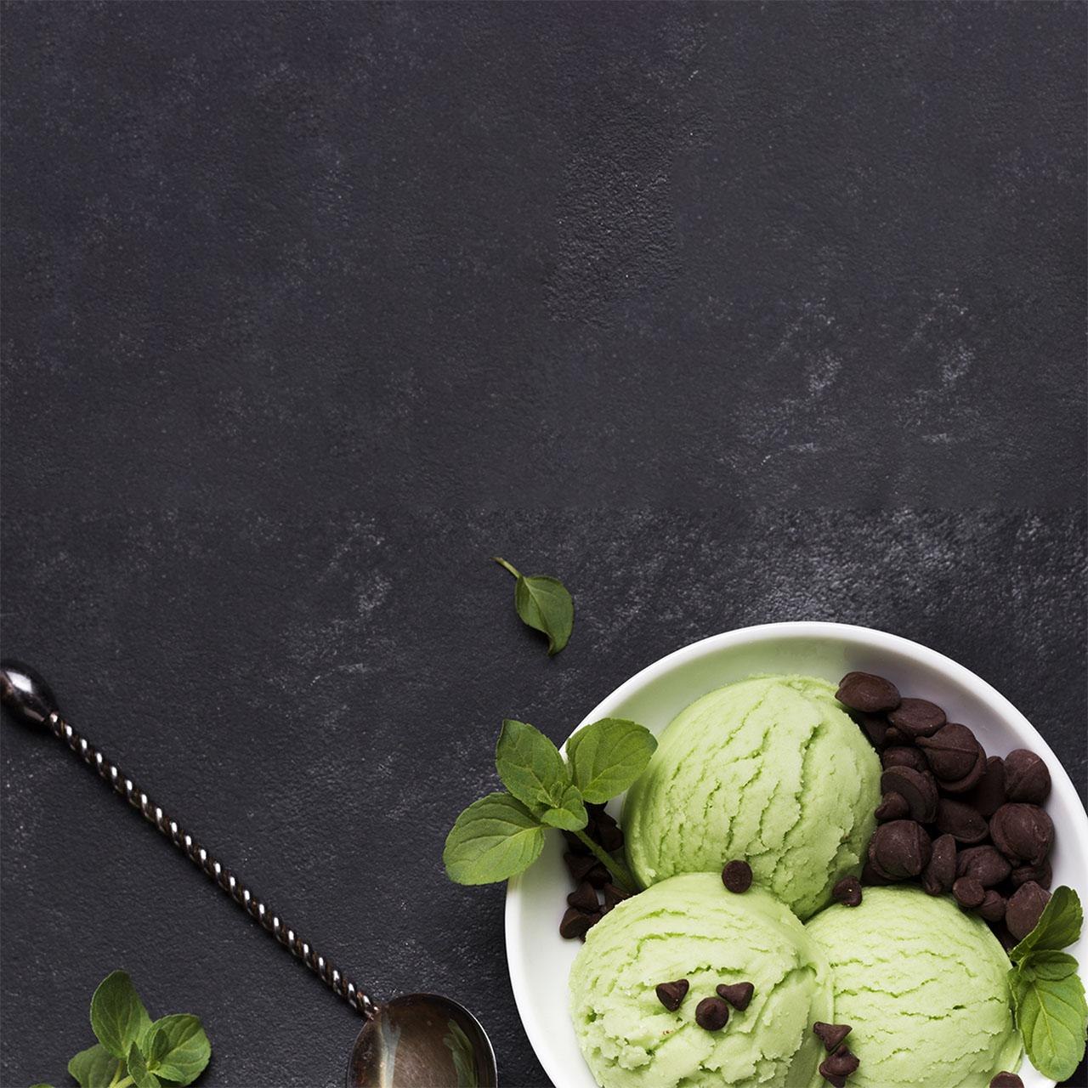
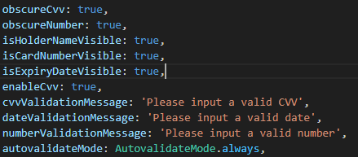
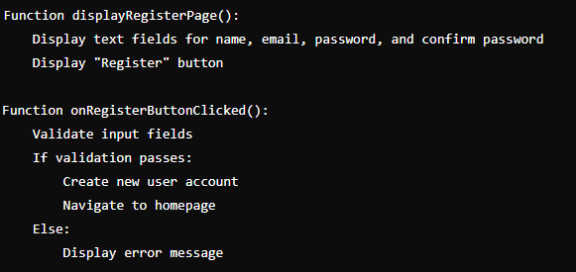
Design Continued
Restaurant List page:
Restaurants, and their addresses.
Order Page:
Items ordered with Order ID, total price.
Login Page:
Email and Password authentication.
Sign up page:
Email and Password, Name

Slide 6

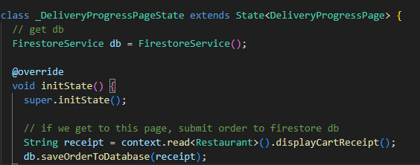
Testing and Bug tracking
Objectives
Ensure the app is free from critical bugs.
Validate that all features work as expected.
Improve user experience by identifying and fixing usability issues.
Maintain high code quality through continuous integration and delivery (CI/CD) practices.
Manual testing of each aspect to make sure they work correctly even with misuse.

Slide 7
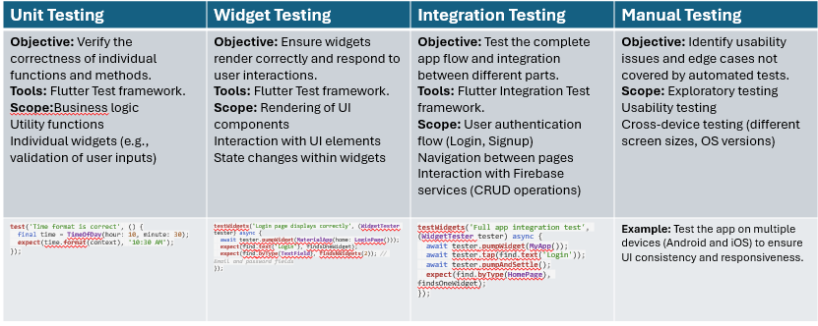

Slide 8
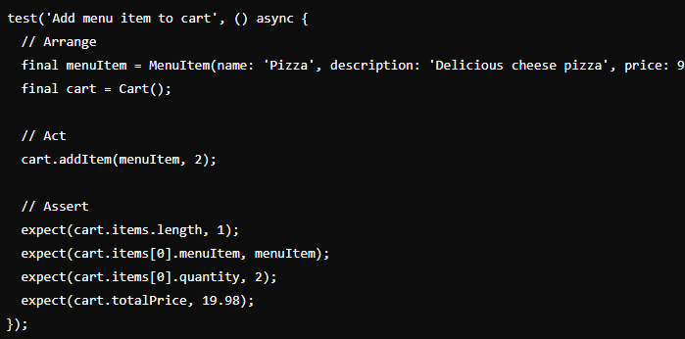
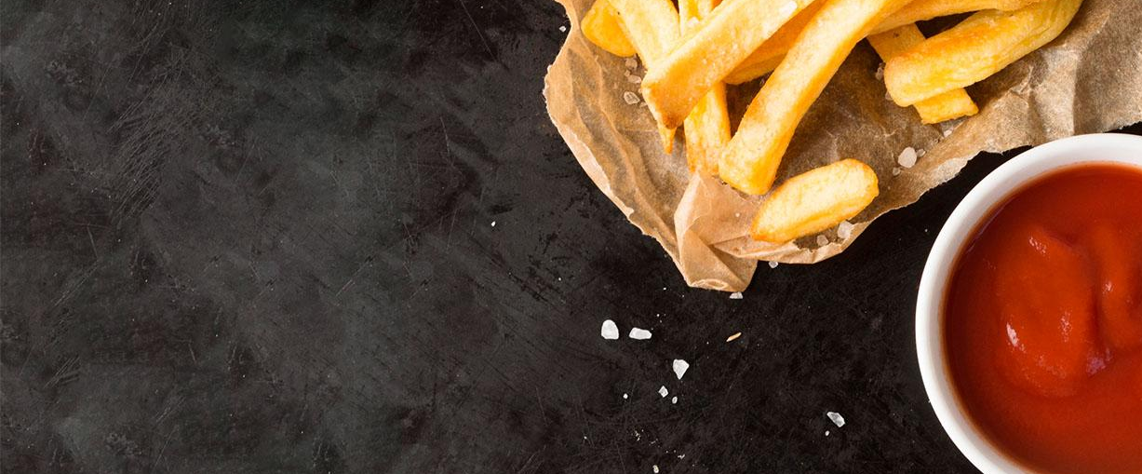
Our company
Test Code
Mercury is the closest planet to the Sun and the smallest one in the Solar System—it’s only a bit larger than our Moon. This planet’s name has nothing to do with the liquid metal, since Mercury was named after a Roman god

Slide 9
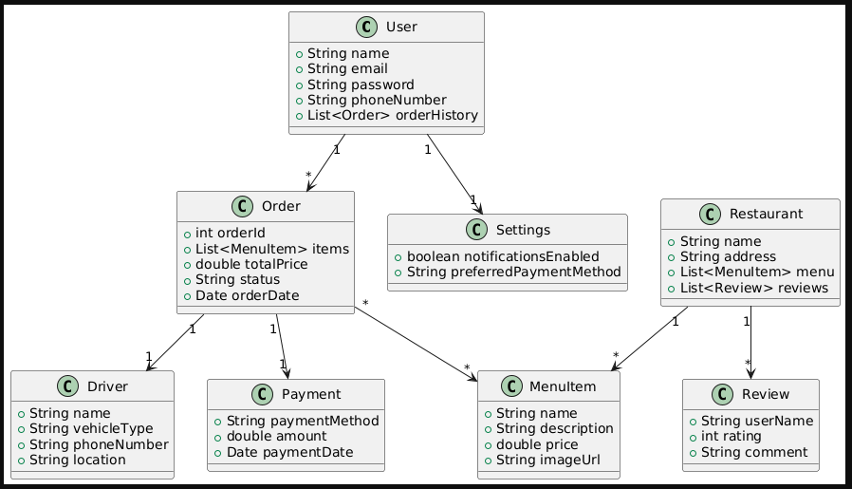
Buyer journey
Class Diagram
Jupiter
Saturn
Mars
Mercury
Jupiter is the biggest planet of them all
Saturn was named after a Roman god
Despite being red, Mars is a cold place
Mercury is the closest planet to the Sun

Slide 10
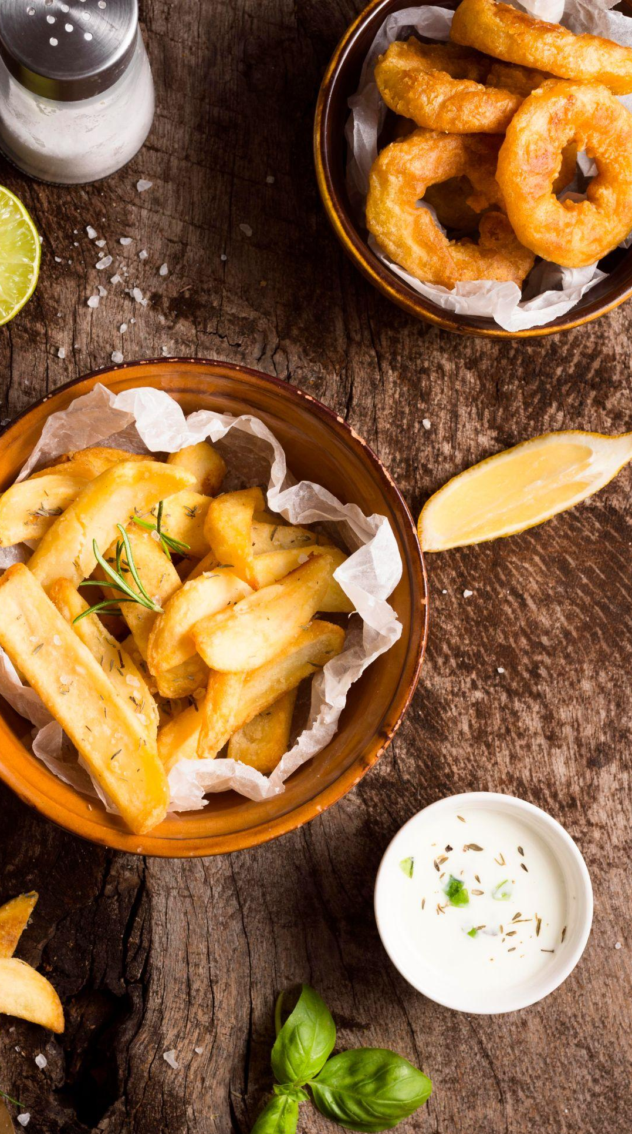
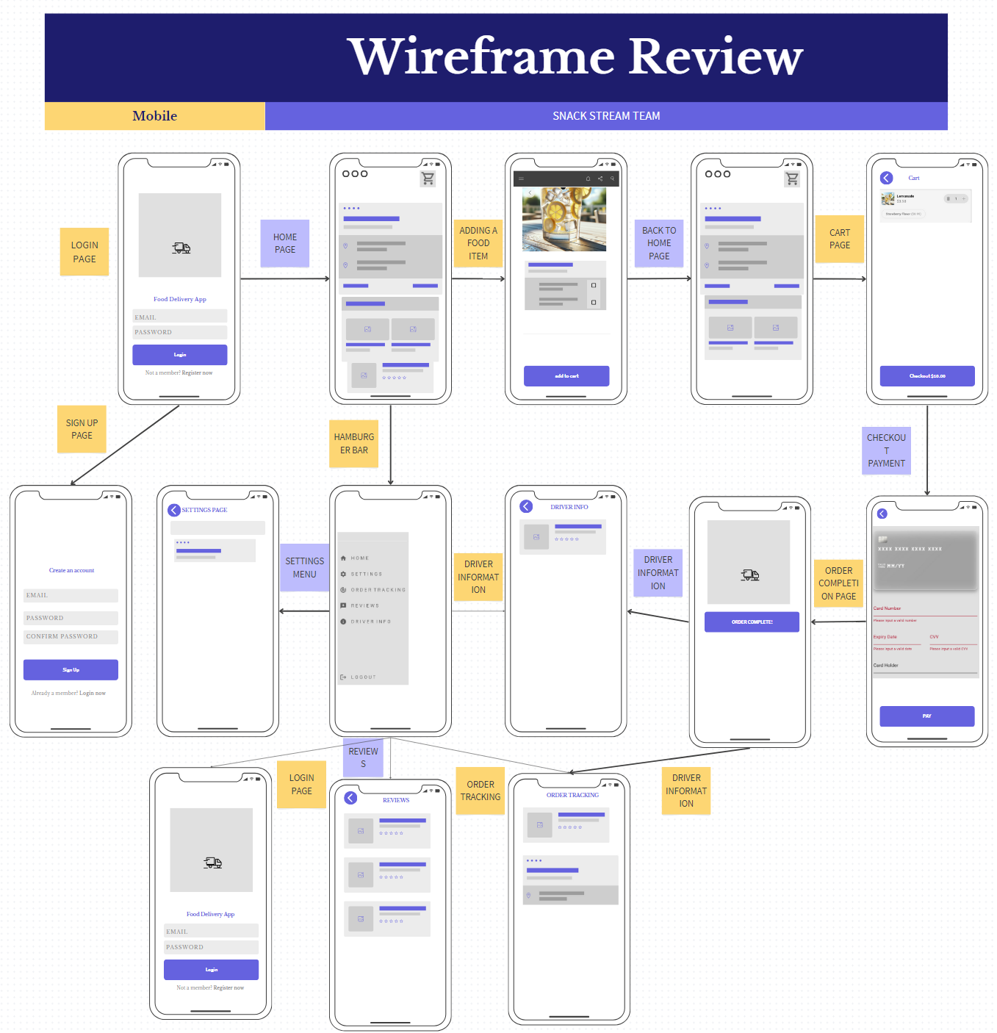
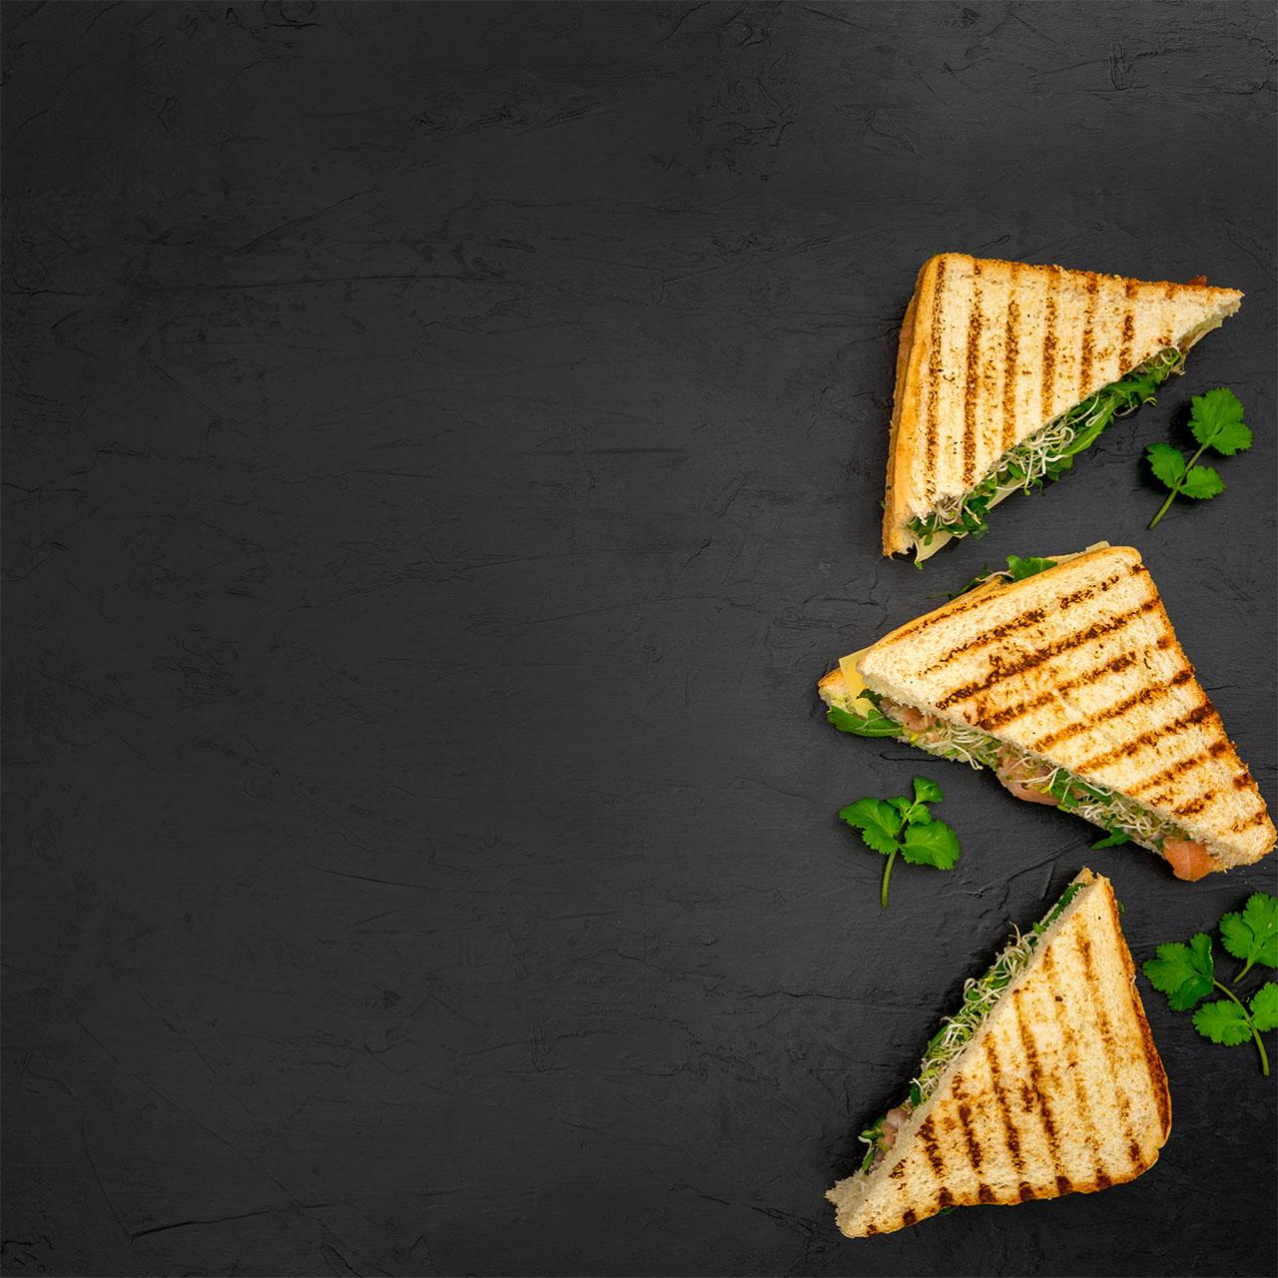
01
About us
You can enter a subtitle here if you need it

Slide 11
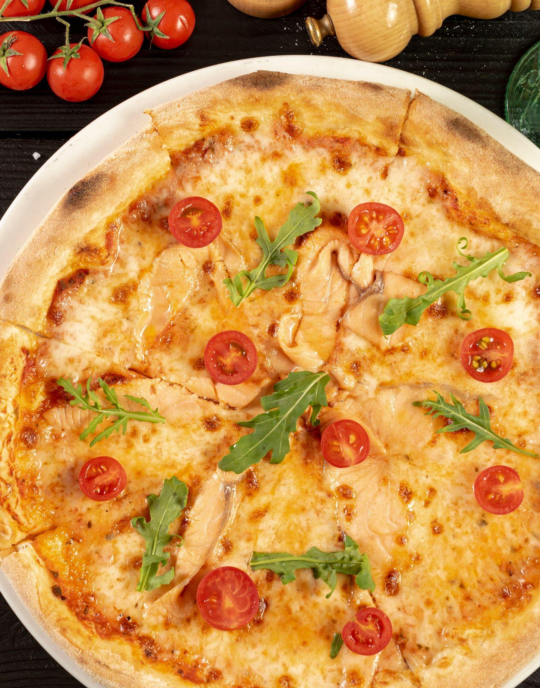

Thanks!
Do you have any questions?
SnackStream TEAM
@Group 9

